Slide 1
TEXT DETECTION IN AN IMAGE USING PYTHON
Under the Guidance of
Ms. Shubha B.
Assistant Professor
A Project Report Submitted By,
Vivek D Naik | 4NM19EC199
Manoj S Bhat | 4NM20EC409
P Vignesh Prabhu | 4NM20EC411
Sampath Kumar | 4NM20EC413

Slide 2
Introduction
Text detection in an using python is a project which will help the user to detect and extract the texts automatically in an image which might also include difficult background.
This project will help the user to copy the text detected from the software and paste it or note it anywhere possible which will help to save a lot of time as well as energy.

Slide 3
Objectives
Capturing or saving the image given by the user.
Recognising and detecting the text and text boundaries in an image.
Extracting the character from the text using OCR.
Obtaining the output.

Slide 4
Methodology
Capturing and saving the image
Reading image using OpenCV.
Detect text and numbers from the image.
Detect each character individually.
Displaying the output

Slide 5
Algorithm
Start();
ConfigCamera();
ReadCamera();
Waitforkey();
While(1)
{
Start;
If (key == space)
{
CaptureImage();
}
else if(key == esc);
{
CloseCamera();
Break;
}
else
{
go-to Start;
}
}
Img=LoadImage(image-name);
Img=Convert_to_RGB;
Text=DetectText();
DrawBoxesOnText();
Print(Text);
Show(Img);
Wait(5000);
Close_all_window();
Stop();

Slide 6
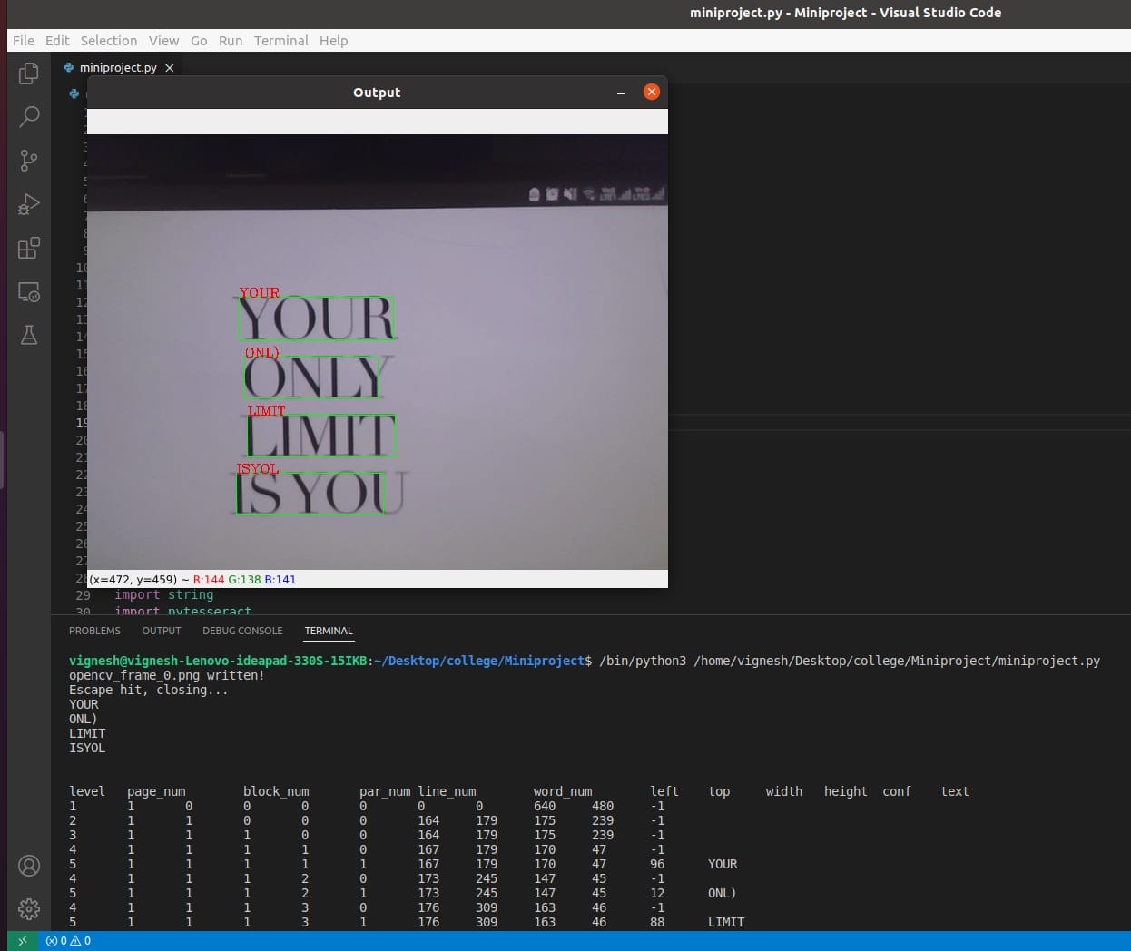
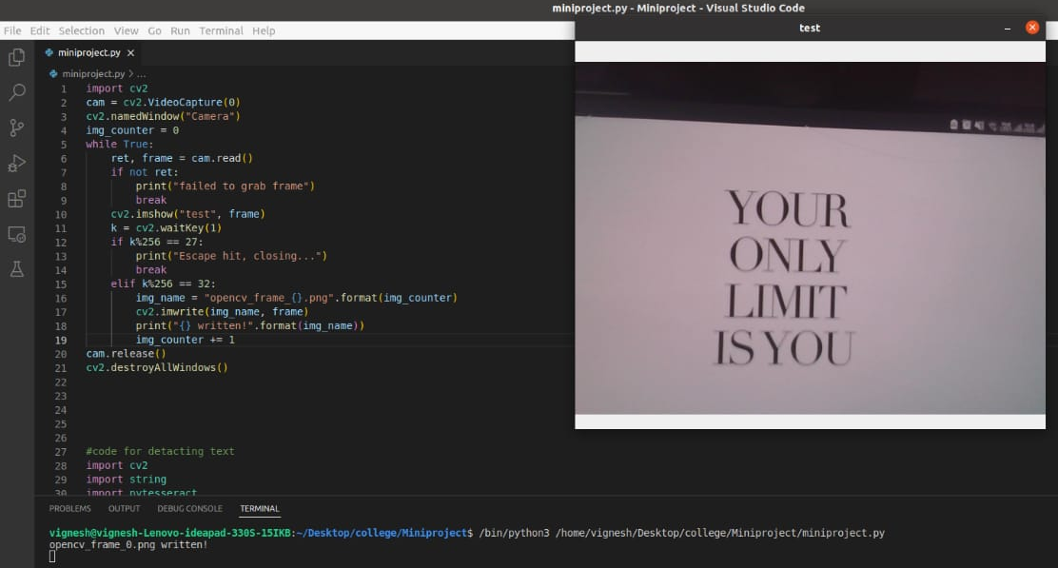
Results
Output
Input

Slide 7
References
[1] Q. Ye and D. Doermann, "Text Detection and Recognition in Imagery: A Survey," in IEEE Transactions on Pattern Analysis and Machine Intelligence, vol. 37, no. 7, pp. 1480-1500, 1 July 2015, doi: 10.1109/TPAMI.2014.2366765.
[2] L. Cao, H. Li, R. Xie and J. Zhu, "A Text Detection Algorithm for Image of Student Exercises Based on CTPN and Enhanced YOLOv3," in IEEE Access, vol. 8, pp. 176924-176934, 2020, doi: 10.1109/ACCESS.2020.3025221.

Slide 8
THANK YOU

